Slide 1
Operating Systems
Unit 1
Chapter 4: Threads

Slide 2
Chapter 4: Threads
Overview
Multicore Programming
Multithreading Models
Threading Issues
Operating System Examples
Thread Libraries

Slide 3
Motivation
Most modern applications are multithreaded and application is implemented as a separate process with several threads.
Multiple tasks with the application like web server can be implemented by separate threads
  Update display
  Fetch data
  Spell checking
  Answer a network request
Like Program having several processes, program can be having several threads
Process creation is heavy-weight while thread creation is light-weight
Can simplify code, increase efficiency
2 types, User threads and Kernel threads
OS Kernels are generally multithreaded

Slide 4

Single and Multithreaded Processes

Slide 5

Multithreaded Server Architecture

Slide 6
Benefits
Responsiveness – may allow continued execution if part of process is blocked, especially important for user interfaces
Resource Sharing – threads share the memory and resources of process, while process only shares resources through shared memory or message passing
Economy – cheaper than process creation, thread switching lower overhead than context switching
Scalability – process can take advantage of multiprocessor architectures

Slide 7
Multicore Programming
Multicore or multiprocessor systems putting pressure on programmers, challenges include:
  Dividing activities to concurrent tasks and each task to a processor/core
  Balance
  Data splitting between various processors/cores
  Data dependency between threads
  Testing and debugging
Parallelism implies a system can perform more than one task simultaneously
Concurrency supports more than one task making progress
  Single processor / core, scheduler providing concurrency

Slide 8

Parallelism
Parallelism on a multi-core system:

Slide 9
Multithreading Models
Many-to-One
One-to-One
Many-to-Many

Slide 10

Many-to-One
Many user-level threads mapped to single kernel thread
One thread blocking causes all to block
Multiple threads may not run in parallel on muticore system because only one may be in kernel at a time
Few systems currently use this model
Examples:
  Solaris Green Threads
  GNU Portable Threads

Slide 11

One-to-One
Each user-level thread maps to kernel thread
Creating a user-level thread creates a kernel thread
More concurrency than many-to-one
Number of threads per application sometimes restricted due to overhead
Examples
  Windows
  Linux
  Solaris 9 and later

Slide 12

Many-to-Many Model
Allows many user level threads to be mapped to many kernel threads
Allows the operating system to create a sufficient number of kernel threads. Kernel thread number may be lesser than user threads
Solaris prior to version 9
Windows with the ThreadFiber package

Slide 13

Two-level Model
Similar to M:M, except that it allows a user thread to be bound to kernel thread
Examples
  IRIX
  HP-UX
  Tru64 UNIX
  Solaris 8 and earlier

Slide 14
Threading Issues
Semantics of fork() and exec() system calls
Signal handling
  Synchronous and asynchronous
Thread Pools
Thread cancellation of target thread
  Asynchronous or deferred
Scheduler Activations

Slide 15
Semantics of fork() and exec()
Does fork()duplicate only the calling thread or all threads?
  Some UNIXes have two versions of fork, one that duplicates all threads and one than duplicates only the calling thread
exec() usually works as normal – replace the running process including all threads

Slide 16
Thread Cancellation
Terminating a thread before it has finished. This may be needed of multiple threads are searching through a database and one returns the result.
Thread to be canceled is target thread
Two general approaches:
  Asynchronous cancellation terminates the target thread immediately
  Deferred cancellation allows the target thread to periodically check if it should be cancelled

Slide 17
Signal Handling
Signals are used in UNIX systems to notify a process that a particular event has occurred.
A signal handler is used to process signals
  Signal is generated by particular event
  Signal is delivered to a process
  Signal is handled by one of two signal handlers:
    default
    user-defined
Every signal has default handler that kernel runs when handling signal
  User-defined signal handler can override default handler
  For single-threaded, signal delivered to process

Slide 18
Signal Handling (Cont.)
Where should a signal be delivered for multi-threaded?
  Deliver the signal to the thread to which the signal applies
  Deliver the signal to every thread in the process
  Deliver the signal to certain threads in the process
  Assign a specific thread to receive all signals for the process

Slide 19
Thread Pools
Create a number of threads in a pool where they await work to avoid the problem of unlimited threads exhausting system resources.
When a server receives a request, it awakens a thread from the pool and passes it to the request for service
Advantages:
  Usually slightly faster to service a request with an existing thread than create a new thread
  Allows the number of threads in the application(s) to be bound to the size of the pool
  Separating task to be performed from mechanics of creating task allows different strategies for running task
    i.e. Tasks could be scheduled to run periodically
Windows API supports thread pools:

Slide 20

Scheduler Activations
Both M:M and Two-level models require communication to maintain the appropriate number of kernel threads allocated to the application
Typically use an intermediate data structure between user and kernel threads – lightweight process (LWP)
  Appears to be a virtual processor on which process can schedule user thread to run
  Each LWP attached to kernel thread
  How many LWPs to create?
Scheduler activations provide upcalls - a communication mechanism from the kernel to the application through the upcall handler in the thread library
This communication allows an application to maintain the correct number of kernel threads

Slide 21
Operating System Examples
Windows Threads
Linux Threads

Slide 22
Windows Threads
Windows implements the Windows API – primary API for Win 98, Win NT, Win 2000, Win XP, and Win 7
Implements the one-to-one mapping, kernel-level
Each thread contains
  A thread id
  Register set representing state of processor
  Separate user and kernel stacks for when thread runs in user mode or kernel mode
  Private data storage area used by run-time libraries and dynamic link libraries (DLLs)
The register set, stacks, and private storage area are known as the context of the thread

Slide 23
Windows Threads (Cont.)
The primary data structures of a thread include:
  ETHREAD (executive thread block) – includes pointer to process to which thread belongs and to KTHREAD, in kernel space
  KTHREAD (kernel thread block) – scheduling and synchronization info, kernel-mode stack, pointer to TEB, in kernel space
  TEB (thread environment block) – thread id, user-mode stack, thread-local storage, in user space

Slide 24

Windows Threads Data Structures

Slide 25

Linux Threads
Linux refers to them as tasks rather than threads
Thread creation is done through clone() system call
clone() allows a child task to share the address space of the parent task (process)
  Flags control behavior
struct task_struct points to process data structures (shared or unique)

Slide 26
Thread Libraries
Thread library provides programmer with API for creating and managing threads
Two primary ways of implementing
  Library entirely in user space
  Kernel-level library supported by the OS

Slide 27
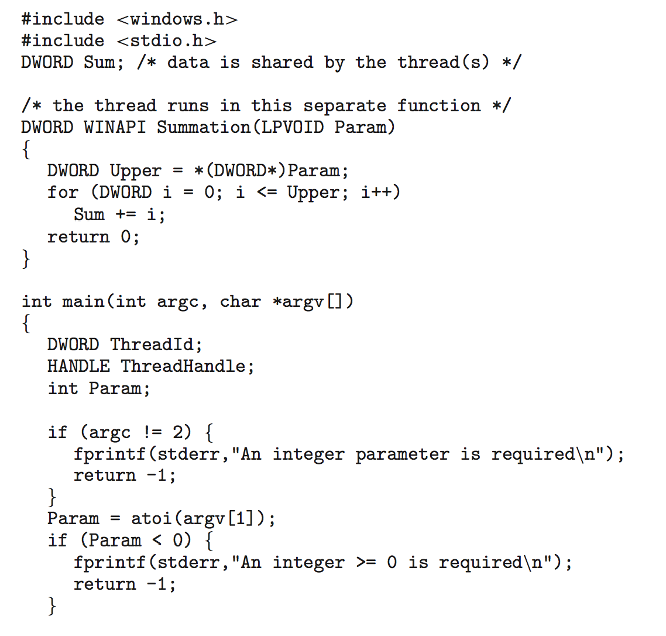
Windows Multithreaded C Program

Slide 28
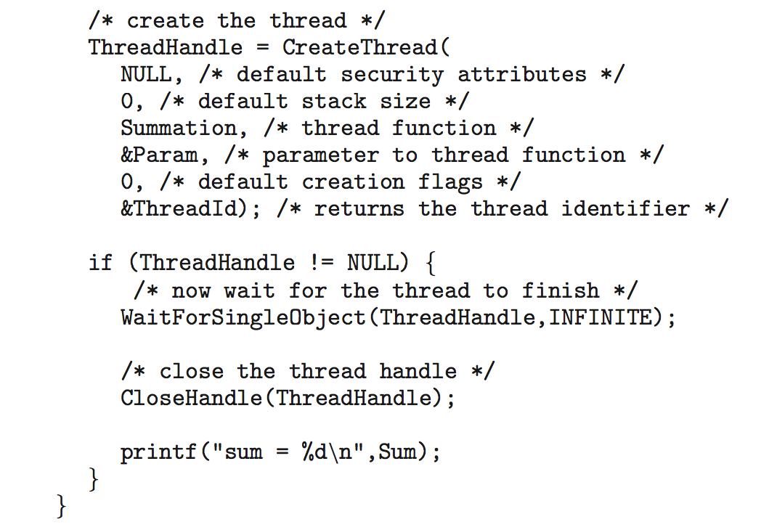
Windows Multithreaded C Program (Cont.)

